Slide 1
Visualizing Data with Matplotlib

Slide 2
Checking for correlation with visualization
Scatterplots
Common chart type
A dot is drawn for each intersection of X and Y
Useful for checking for correlation between columns of data
There is correlation when a change in one column is bound to the value of another column
Examples
A correlation exists between number of car accidents on a given day and the amount of snowfall
No correlation exists between amount of snowfall on a given day and the Microsoft stock price

Slide 3
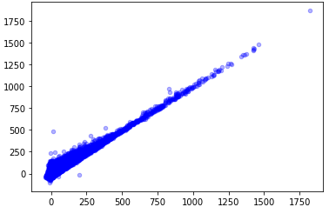
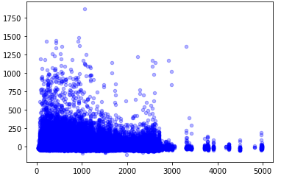
Scatterplot examples
Correlation
No Correlation

Slide 4
Using matplotlib to draw graphs
Import the library
import matplotlib.pyplot as plt
Create plots directly from the DataFrame
delays_df = pd.read_csv('Data/Lots_of_flight_data.csv')
delays_df.plot(kind='scatter',
x='DISTANCE', y='ARR_DELAY',
color='blue', alpha=0.3,
title='Correlation arrival and distance')
plt.show()

Slide 5
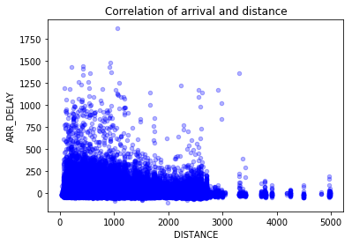
delays_df.plot(kind='scatter',x='DISTANCE',y='ARR_DELAY', color='blue', alpha=0.3, title='Correlation of arrival and distance')
generates the following graph

Slide 6
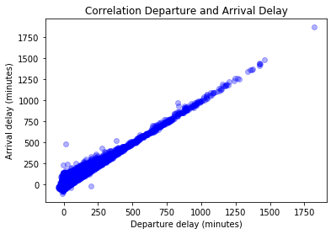
plt.xlabel('Departure delay (minutes)')
plt.ylabel('Arrival delay (minutes)')
plt.title('Correlation Departure and Arrival Delay')
plt.scatter(x=delays_df['DEP_DELAY'],
y=delays_df['ARR_DELAY'],
color='blue', alpha=0.3)
plt.show()

Slide 7
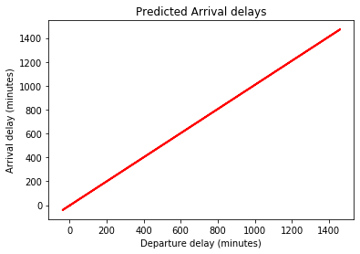
You can draw a line graph to show the predicted values of a trained model
plt.xlabel('Departure delay (minutes)')
plt.ylabel('Arrival delay (minutes)')
plt.title('Predicted Arrival delays')
plt.plot(
X_test,
y_pred,
color='red',
linewidth=2
)
plt.show()

Slide 8
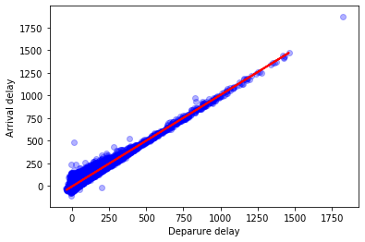
Overlay the model on our data
plt.xlabel('Deparure delay')
plt.ylabel('Arrival delay')
plt.plot(X_test, y_pred, color='red', linewidth=2)
plt.scatter(x=delays_df['DEP_DELAY'],
y=delays_df['ARR_DELAY'],
color='blue',
alpha=0.3)
plt.show()

